Slide 1
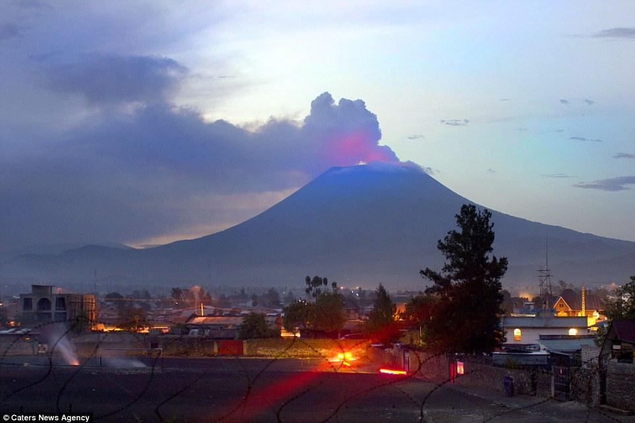

Time Series Analysis of Transient Deformation and Magmatism in the Kivu Rift, Western Branch of the East African Rift System
D. Murekezi ¹, A. Newman¹, K. Murray ², C. Wauthier ³, E.Mudakikwa ⁴, T.Niyitegeka ⁵ ,C. Ebinger ⁶, P Lundgren ⁷
1. Georgia Tech, 2. University of Hawaii, 3. Penn State, 4. REMA, 5. RMB, 6.Tulane University, 7. Cal Tech

Slide 2
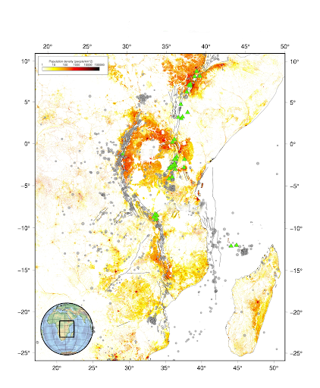
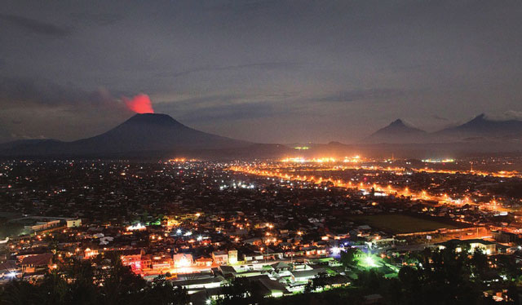
africamuseum.be
East African Rift System, as outlined by seismicity (grey) and volcanoes (green)
Made of 2 major branches, East and Western Branch where the Kivu rift is developing
Mt. Nyiragongo volcano is located in the center of the Kivu rift, part of the Virunga Volcanic Zone
Over 2 million people live in the proximity of the Virunga volcanoes in both Gisenyi (Rwanda) and Goma ( Democratic Republic of Congo)
JUDITH HUBBARD & KYLE BRADLEY

Slide 3
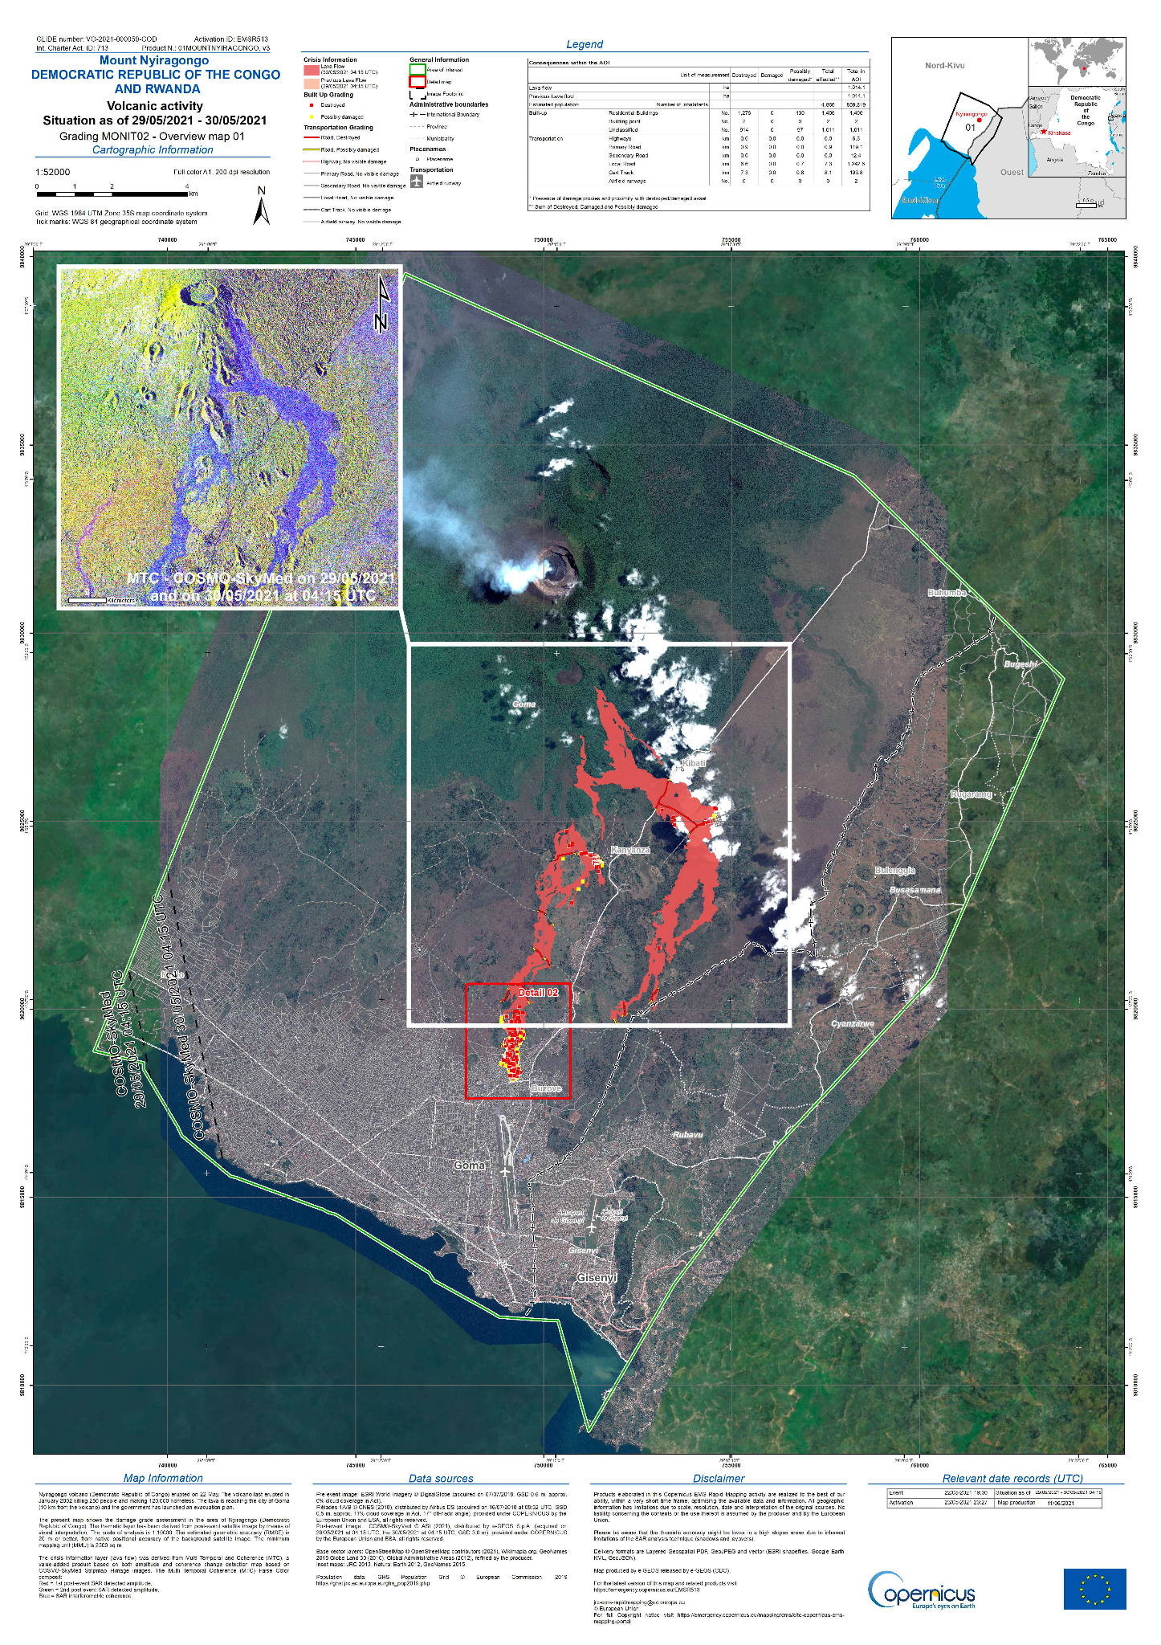
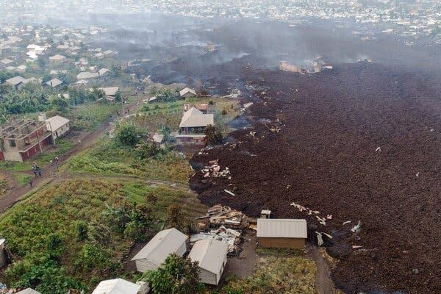
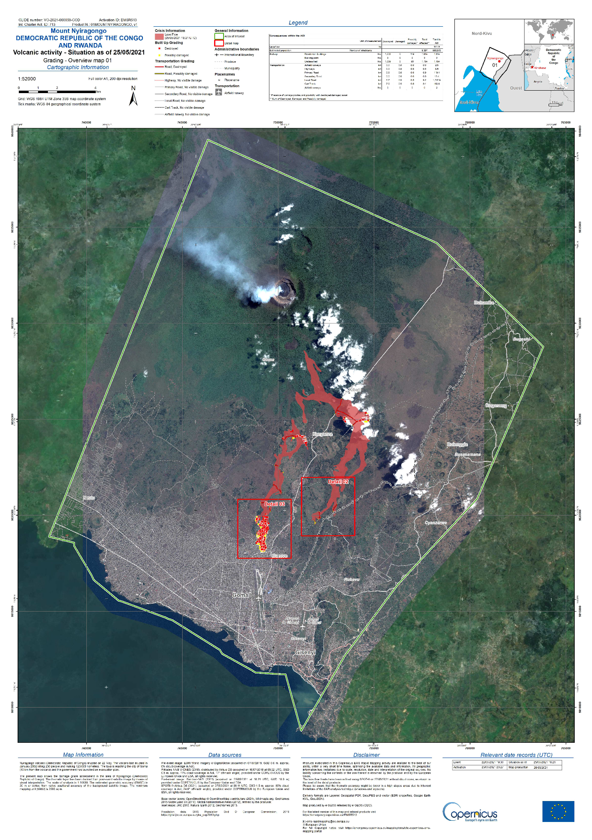
Motel in Gisenyi, Rwanda
Close to 300,000 people were affected by the eruption including 32 deaths
Ensuing earthquakes and ground deformation destroyed major infrastructure like roads, water and electricity lines in Goma and Gisenyi

Slide 4
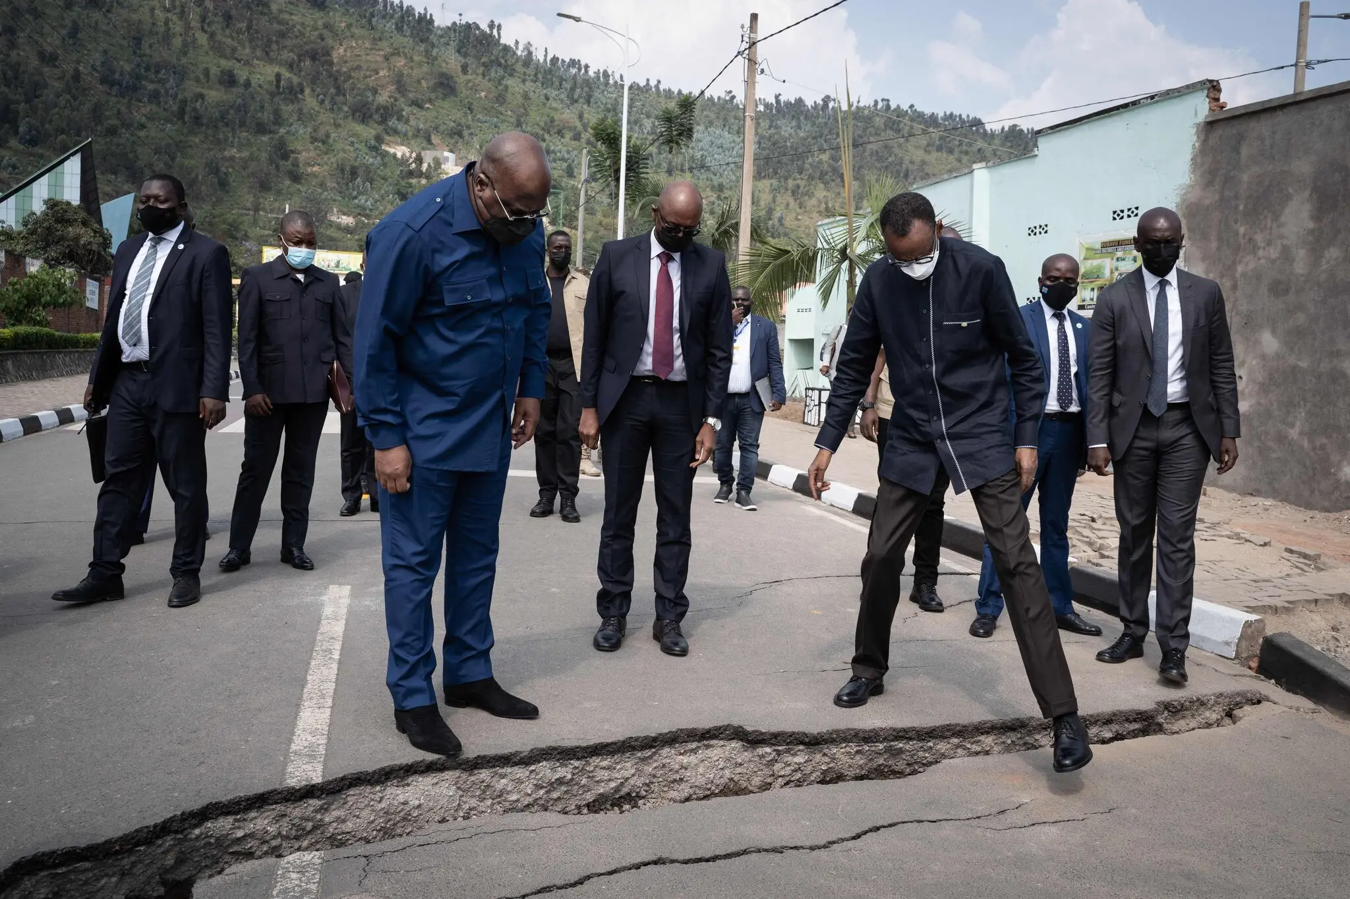
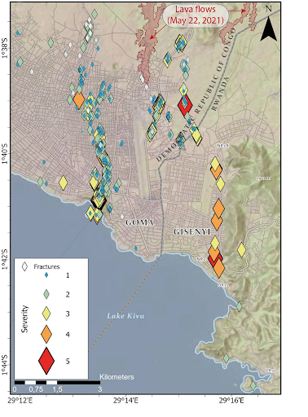
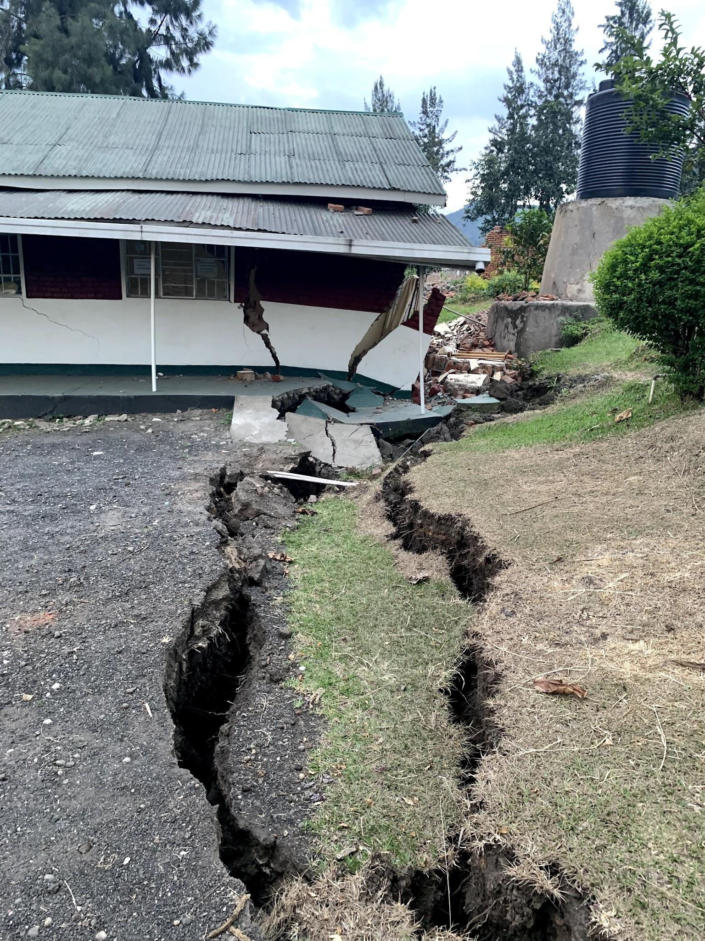
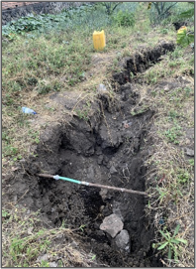
President of Rwanda and President of DRC examining the fissure opening in Gisenyi. cc:NYT
Over 1 m of fissure opening observed in Gisenyi and Goma following the May 22, 2021 eruption
Parallel fissure tracks were mapped extending from Gisenyi and Goma to the volcano
Parallel fissure tracks mapped in Goma and Gisenyi
[G. Boudoire et al., (2021)]

Slide 5
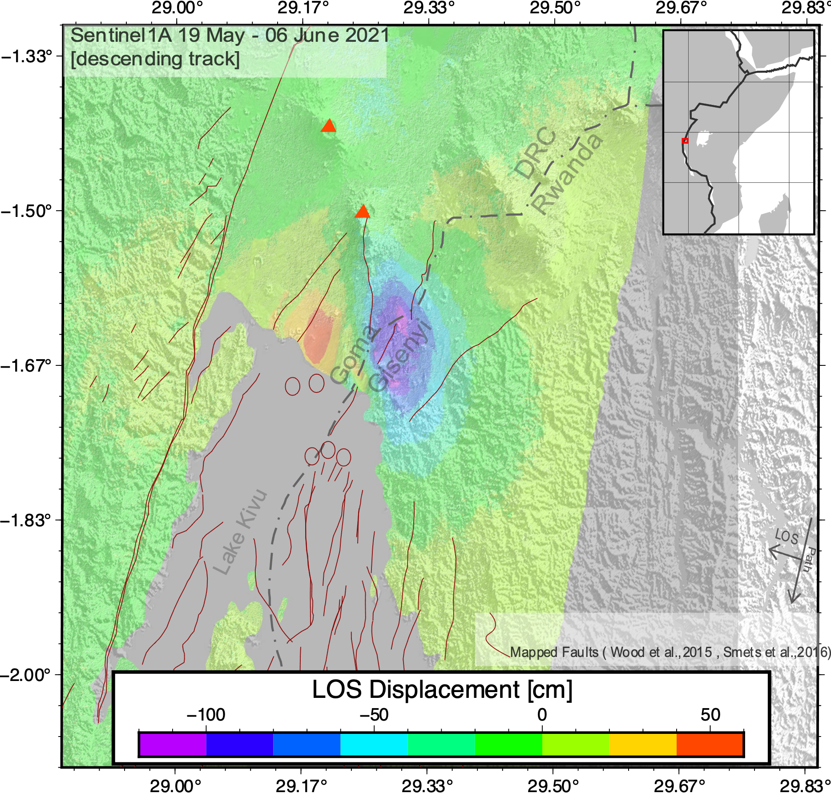
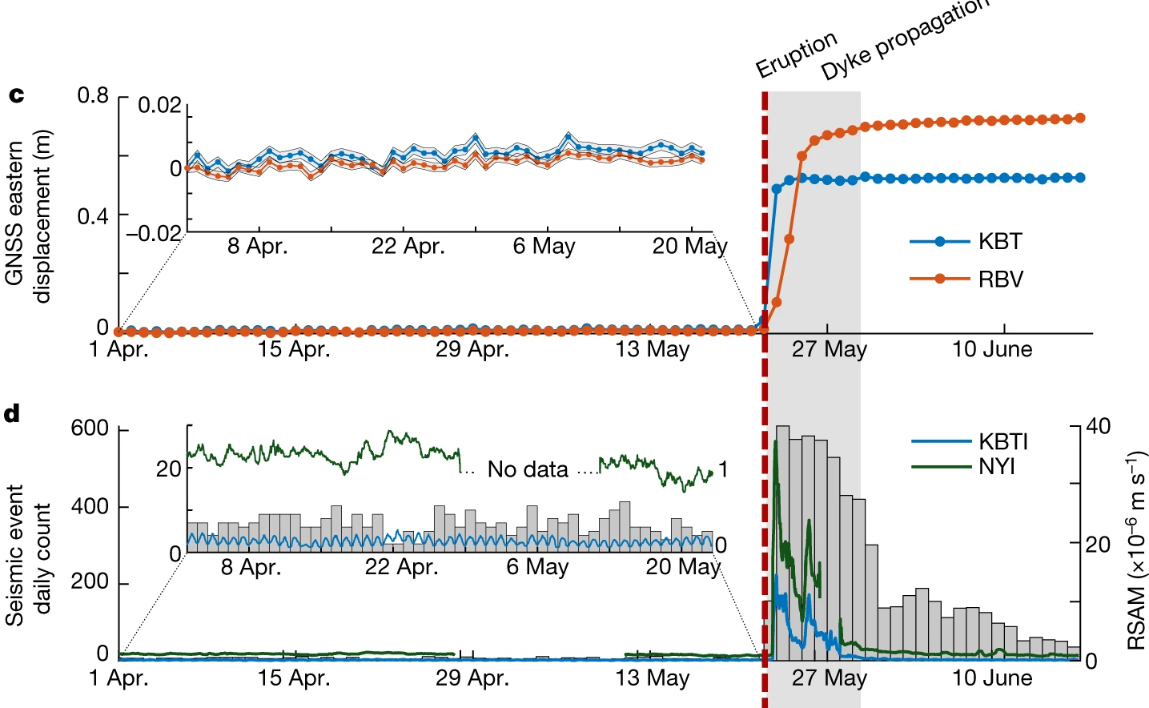
On May 22, 2021;
Sentinel 1 recorded subsidence and uplift signal around the towns of Goma (on the Congolese side) and Gisenyi on the Rwandan side
Preliminary models [e.g. Murekezi et al.,(2021)] interpreted the signal to be associated to a dike intrusion underneath Goma and Gisenyi
Modified from D. Smittarello et al., (2022)
Here we ;
Use a set of tools (SARTS, ISCE, SNAPHU, and MintPy) to process a stack of interferograms
Analyze the transient deformation in the InSAR time series covering the Goma-Gisenyi area from May 2020 to December 2022
Nyiragongo

Slide 6
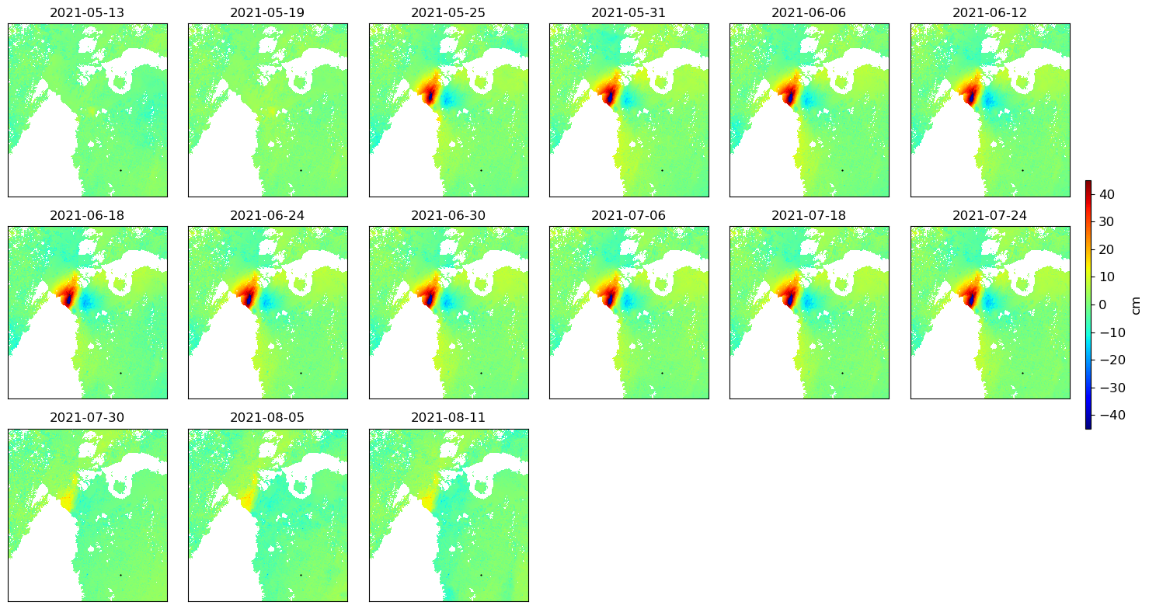
LOS
22- May Lava Eruption
Deformation signal first recorded 3 days after the May 22 eruption
Strongest deformation signal was recorded 20 Km south of Nyiragongo volcano concentrating underneath Goma and Gisenyi
Over 30 cm of uplift and subsidence signal for over 2 months after the the eruption

Slide 7
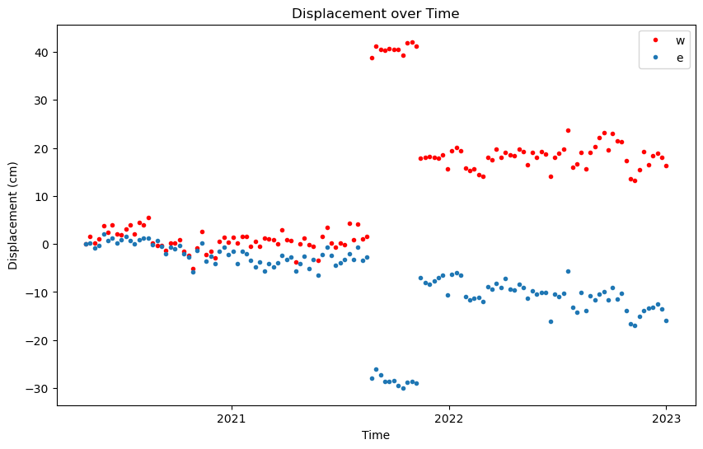
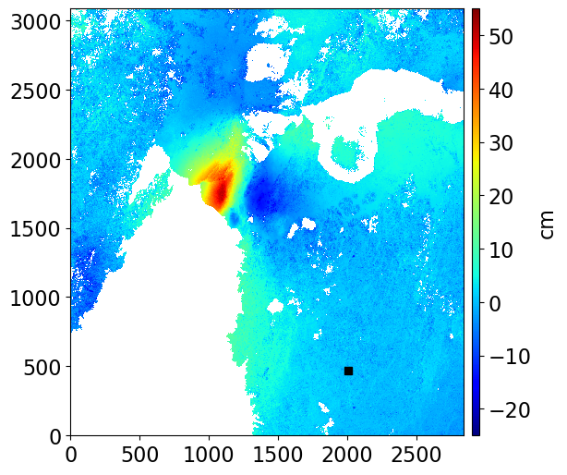
Displacement over time [May 2020- December 2022] for 2 points (w in Goma, e in Gisenyi)
w
e
Eruption: May 22, 2021
The onset of recorded LOS deformation is concurrent with the May 22, 2021 eruption
Over 30 cm of uplift and subsidence is recorded for the period of May 2021 to July 2021

Slide 8
LOS
22- May Lava Eruption
24- July Ash Eruption?
Deformation signal first recorded 3 days after the May 22 eruption
Strongest deformation signal was recorded 20 Km south of Nyiragongo volcano concentrating underneath Goma and Gisenyi
Over 30 cm of uplift and subsidence signal for over 2 months after the the eruption

Slide 9
Displacement over time [May 2020- December 2022] for 2 points (w in Goma, e in Gisenyi)
July 24, 2021
w
e
Around July 24th, point w drops to 20 cm of uplift maintained up to the end of the time series, point e displacement decreases similarly and maintains subsidence signal of over 10 cm

Slide 10
Displacement over time [May 2020- December 2022] for 2 points (w in Goma, e in Gisenyi)
July 24, 2021
w
e
Eruption: May 22, 2021
The onset of recorded LOS deformation is concurrent with the May 22, 2021 eruption
Over 30 cm of uplift and subsidence is recorded for the period of May 2021 to July 2021
Around July 24th, point w drops to 20 cm of uplift maintained up to the end of the time series, point e displacement decreases similarly and maintains subsidence signal of over 10 cm

Slide 11
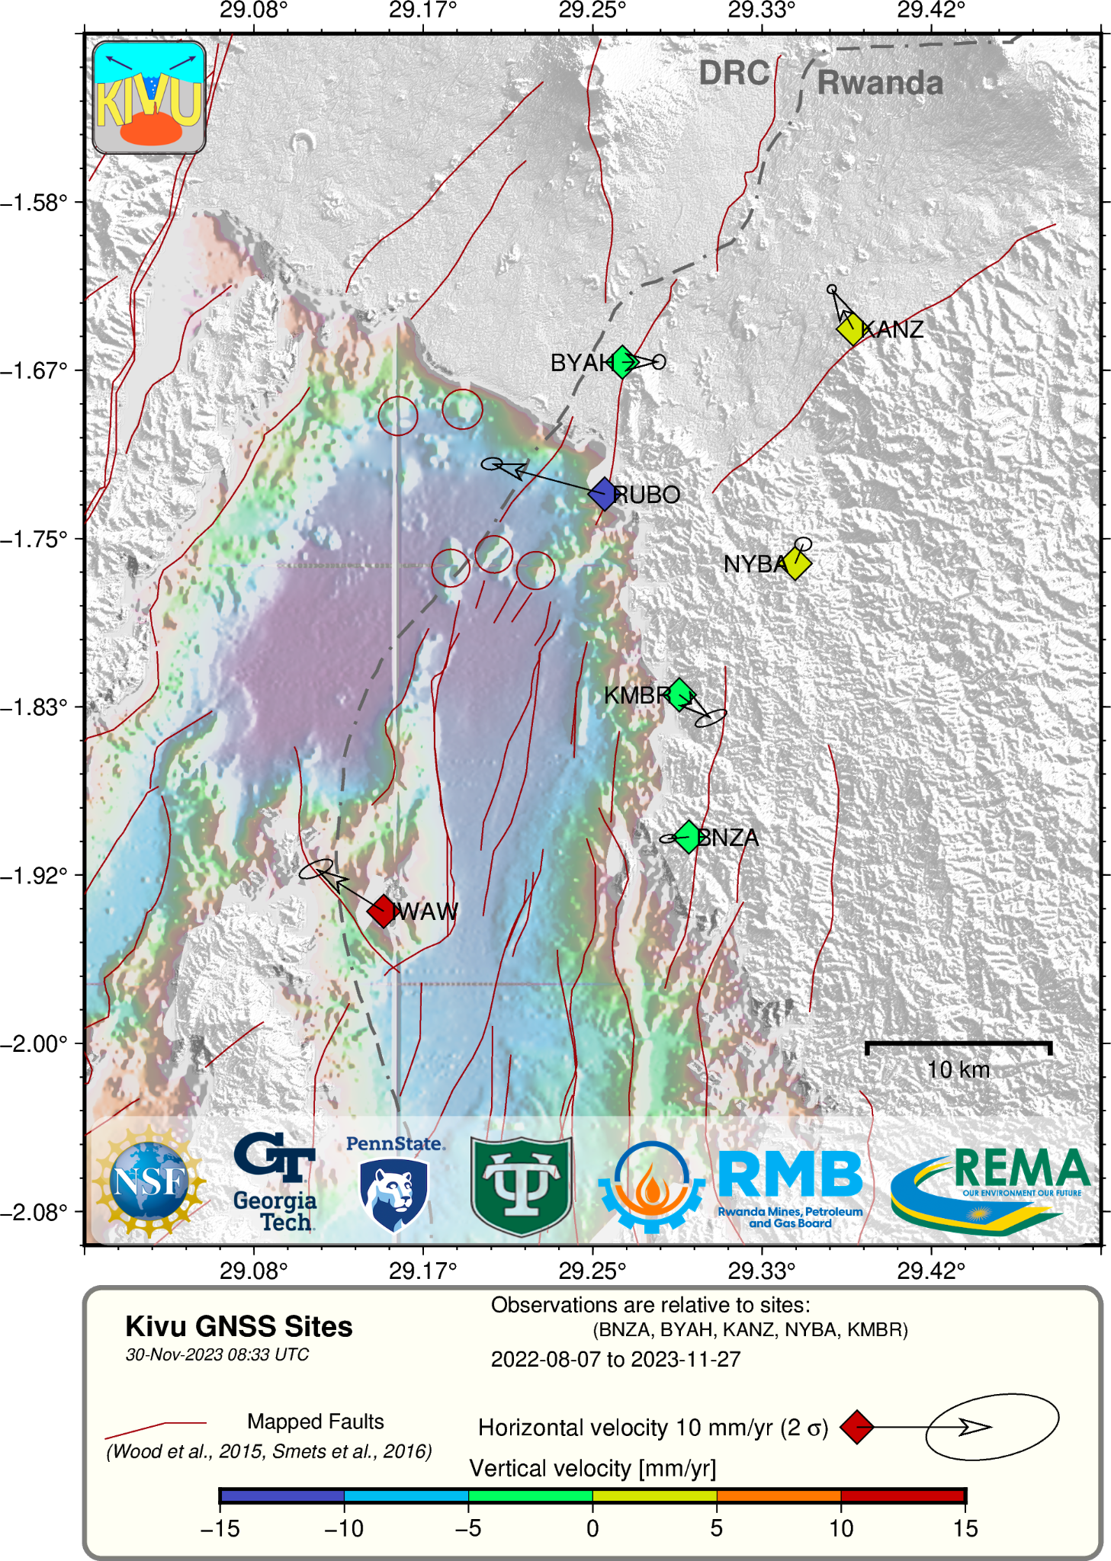
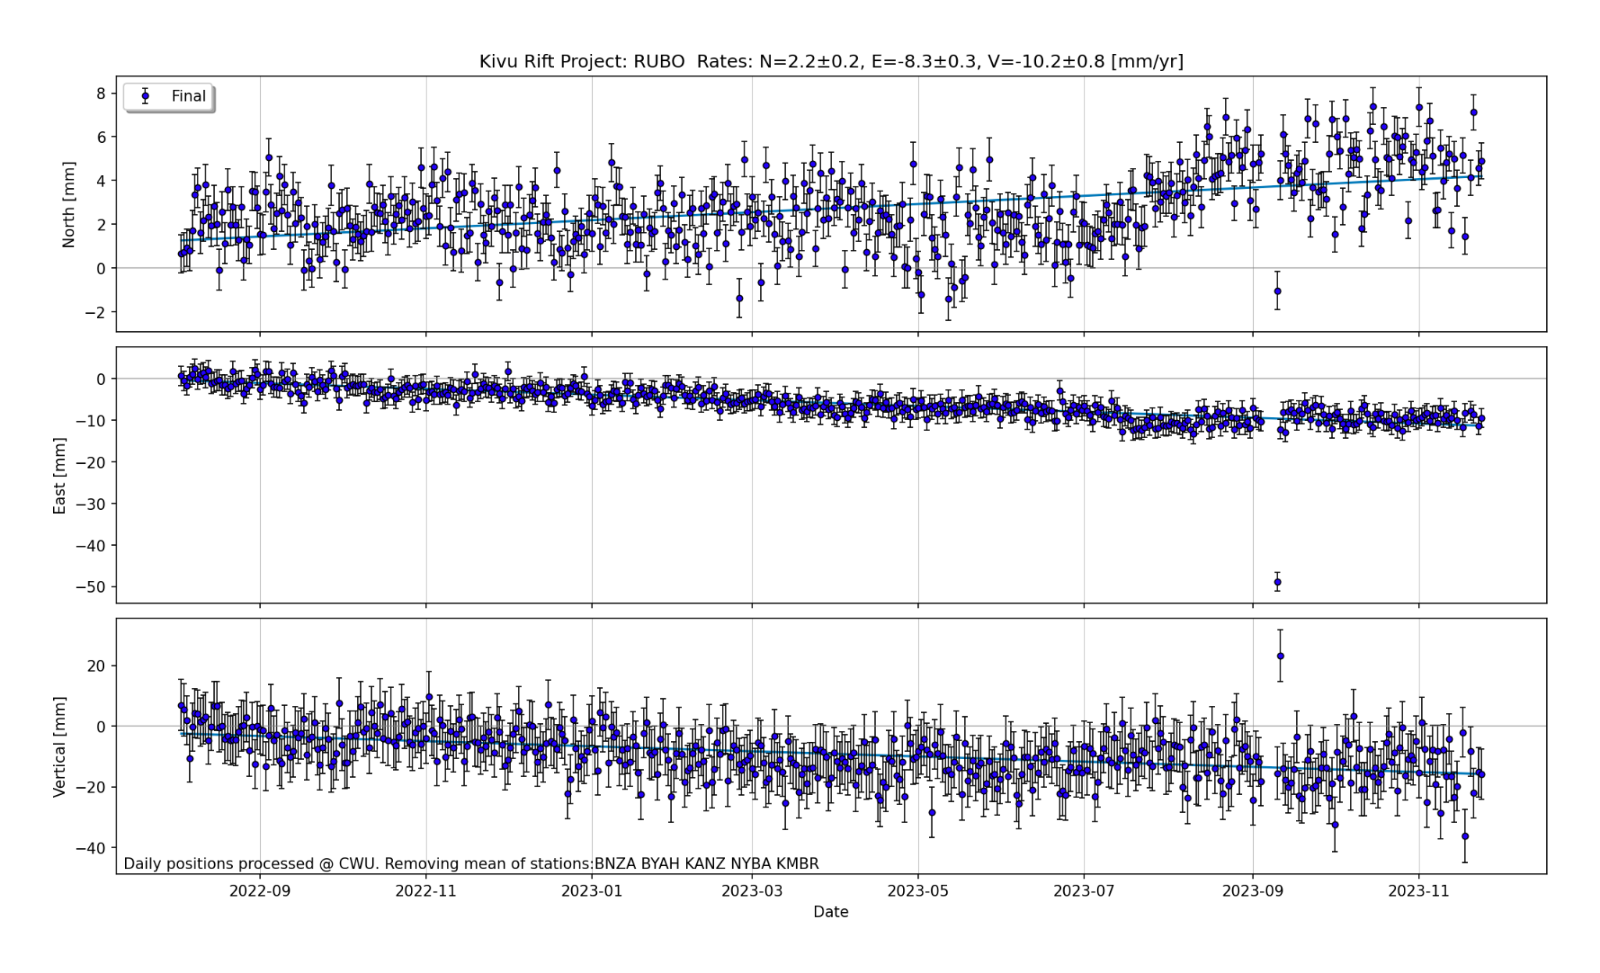
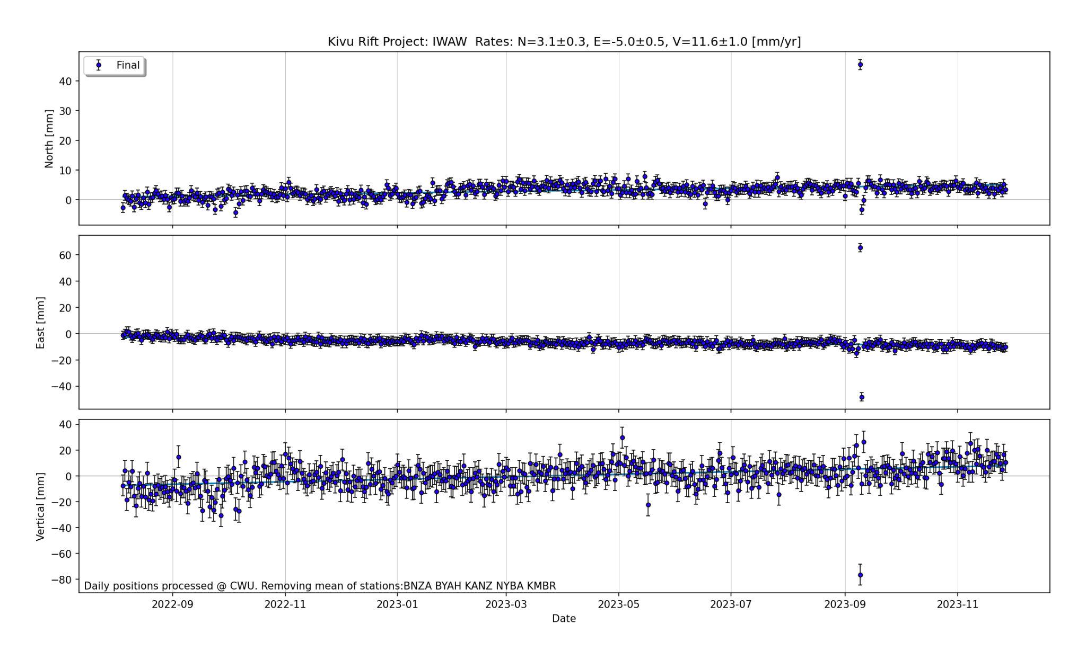
GNSS Network installed in Aug-2022 shows continued deformation especially RUBO that shows ~10 mm/yr downward movement in the area that InSAR showed significant subsidence signal following the eruption.

Slide 12
Summary
Co-eruptive seismicity indicated a southward migration of a dike intrusion towards Lake Kivu [e.g. D. Smittarello et al., (2022)]
InSAR data showed a significant uplift and subsidence signal underneath Goma and Gisenyi
InSAR time series analysis shows displacement signal concurrent with the Nyiragongo eruption on May 22, 2021
Deformation underneath Goma and Gisenyi continued for over 2 months after the eruption, and changed by ~10 cm around July 24th, 2021
GPS data from August 2022 shows continued vertical displacement
July 24, 2021
Eruption: May 22, 2021

Slide 13
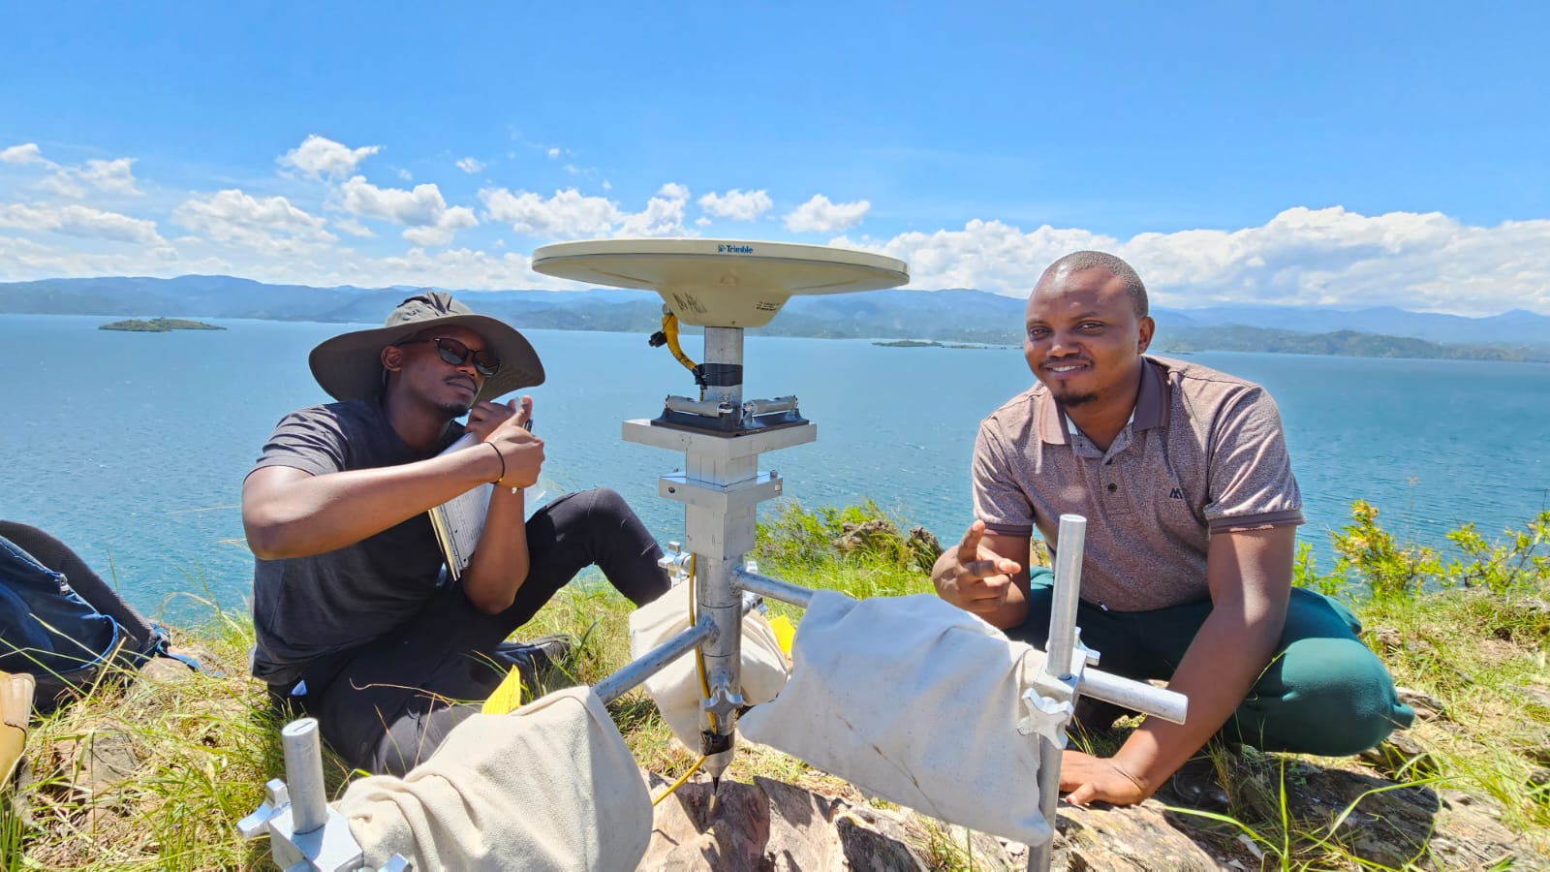
THANK YOU FOR YOUR ATTENTION!
For any questions email: murekezi@gatech.edu

Slide 14
References
Boudoire, G., Calabrese, S., Colacicco, A., Sordini, P., Habakaramo Macumu, P., Rafflin, V., ... & Tedesco, D. (2022). Scientific response to the 2021 eruption of Nyiragongo based on the implementation of a participatory monitoring system. Scientific Reports, 12(1), 7488.
Smittarello, D., Smets, B., Barrière, J., Michellier, C., Oth, A., Shreve, T., ... & Syavulisembo Muhindo, A. (2022). Precursor-free eruption triggered by edifice rupture at Nyiragongo volcano. Nature, 609(7925), 83-88.
Judith H & K Bradley (2023, November 29). M5 Earthquake in East African Rift. Earthquake Insights. https://earthquakeinsights.substack.com/p/m5-earthquake-in-east-african-rift
Yunjun, Z., H. Fattahi, F. Amelung (2019), Small baseline InSAR time series analysis: Unwrapping error correction and noise reduction, Computers & Geosciences, 133, 104331, doi:10.1016/j.cageo.2019.104331.
Rosen, P. A., E. Gurrola, G. F. Sacco, and H. Zebker (2012), The InSAR scientific computing environment, paper presented at EUSAR 2012, 23-26 April 2012

